Slide 1
Tree Based Methods in Machine Learning
Akshay Sehgal
20th March 1990

Slide 2
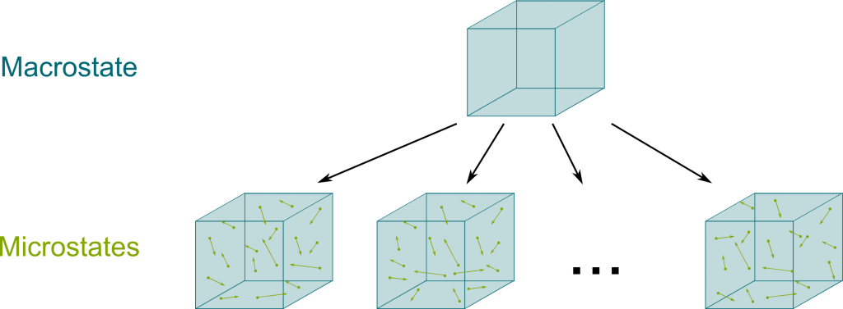

Concept of Entropy
Entropy deals with the number of microstates that are consistent with a given macrostate. Entropy talks about how many such states can a system exist in.
Say we have two containers of gas, and we know the macroscopic properties of both. There are N1 possible "microstates" for the first container, and N2 for the second. What are the possible microstates for the system that consists of both containers?

Slide 3
Section Title

